Slide 1
Lesson 21 – Homework review

Slide 2
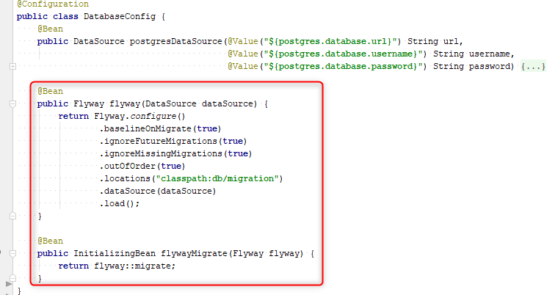
Be careful using custom Flyway config with Spring Boot

Slide 3
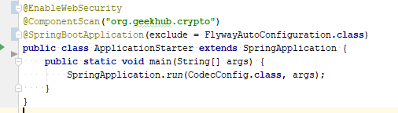
Be careful using custom Flyway config with Spring Boot

Slide 4
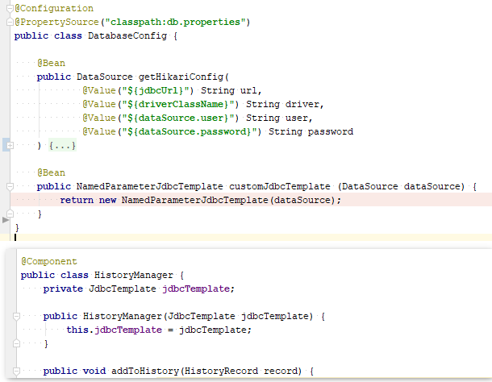
Declare and use same beans

Slide 5
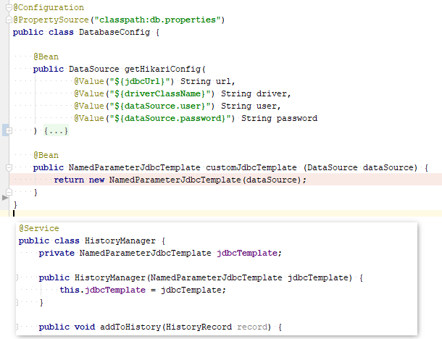
Declare and use same beans

Slide 6
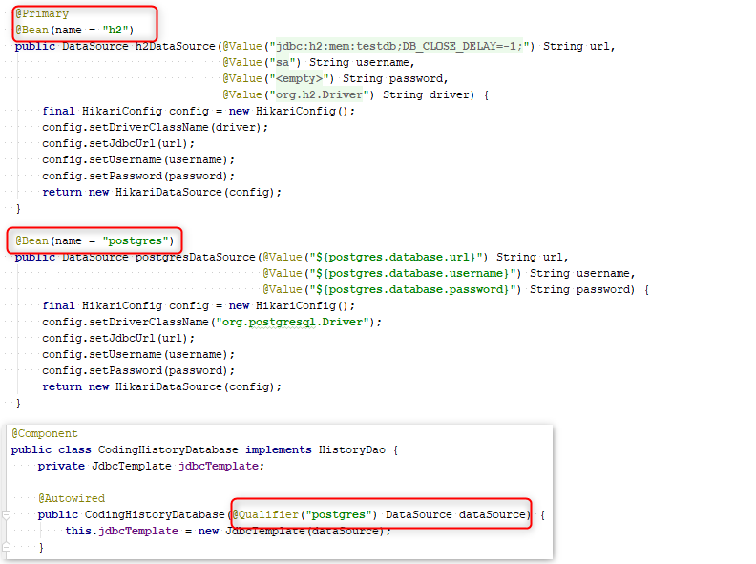
Do not declare 2 same beans for different proposes

Slide 7
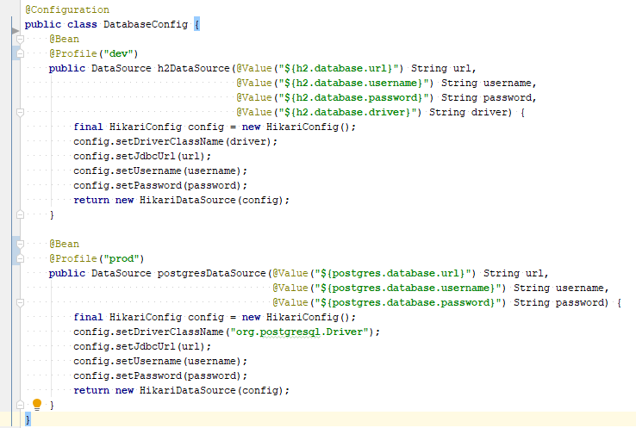
Do not declare 2 same beans for different proposes

Slide 8
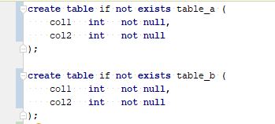
Do not create few tables in one migration

Slide 9


Use versioned migrations to create tables

Slide 10
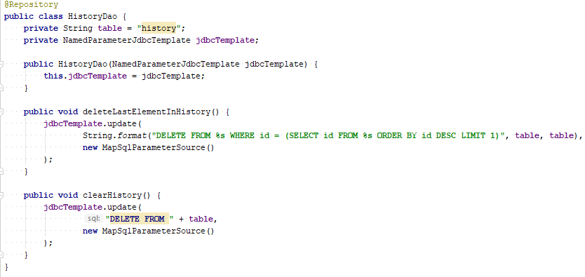
Do not generate SQL using format of concat

Slide 11
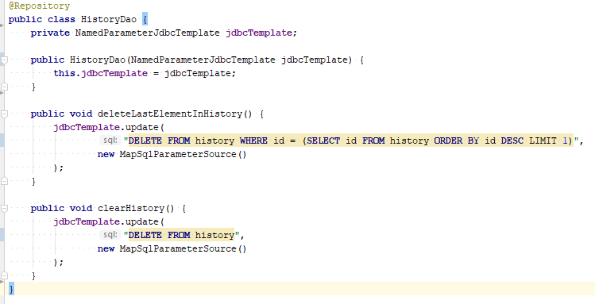
Do not generate SQL using format of concat

Slide 12
Apply recommendations from personal feedbacks before starting next homework

